Slide 1
Enhanced ATM Security: Facial Analysis for Profile Monitoring and Alerting
Prepared by Pius Yee (DSI-SG-42)

Slide 2
Introduction
Automated Teller Machines (ATMs) have become an essential part of our daily lives
However, our reliance on physical cards and PINs exposes them to theft, such as ATM skimming, which compromises card information and PINs for fraudulent withdrawals.
ATM skimming is a type of payment card fraud. It’s a way of stealing PINs and other information off credit cards and debit cards by rigging machines with hidden recording devices.

Slide 3
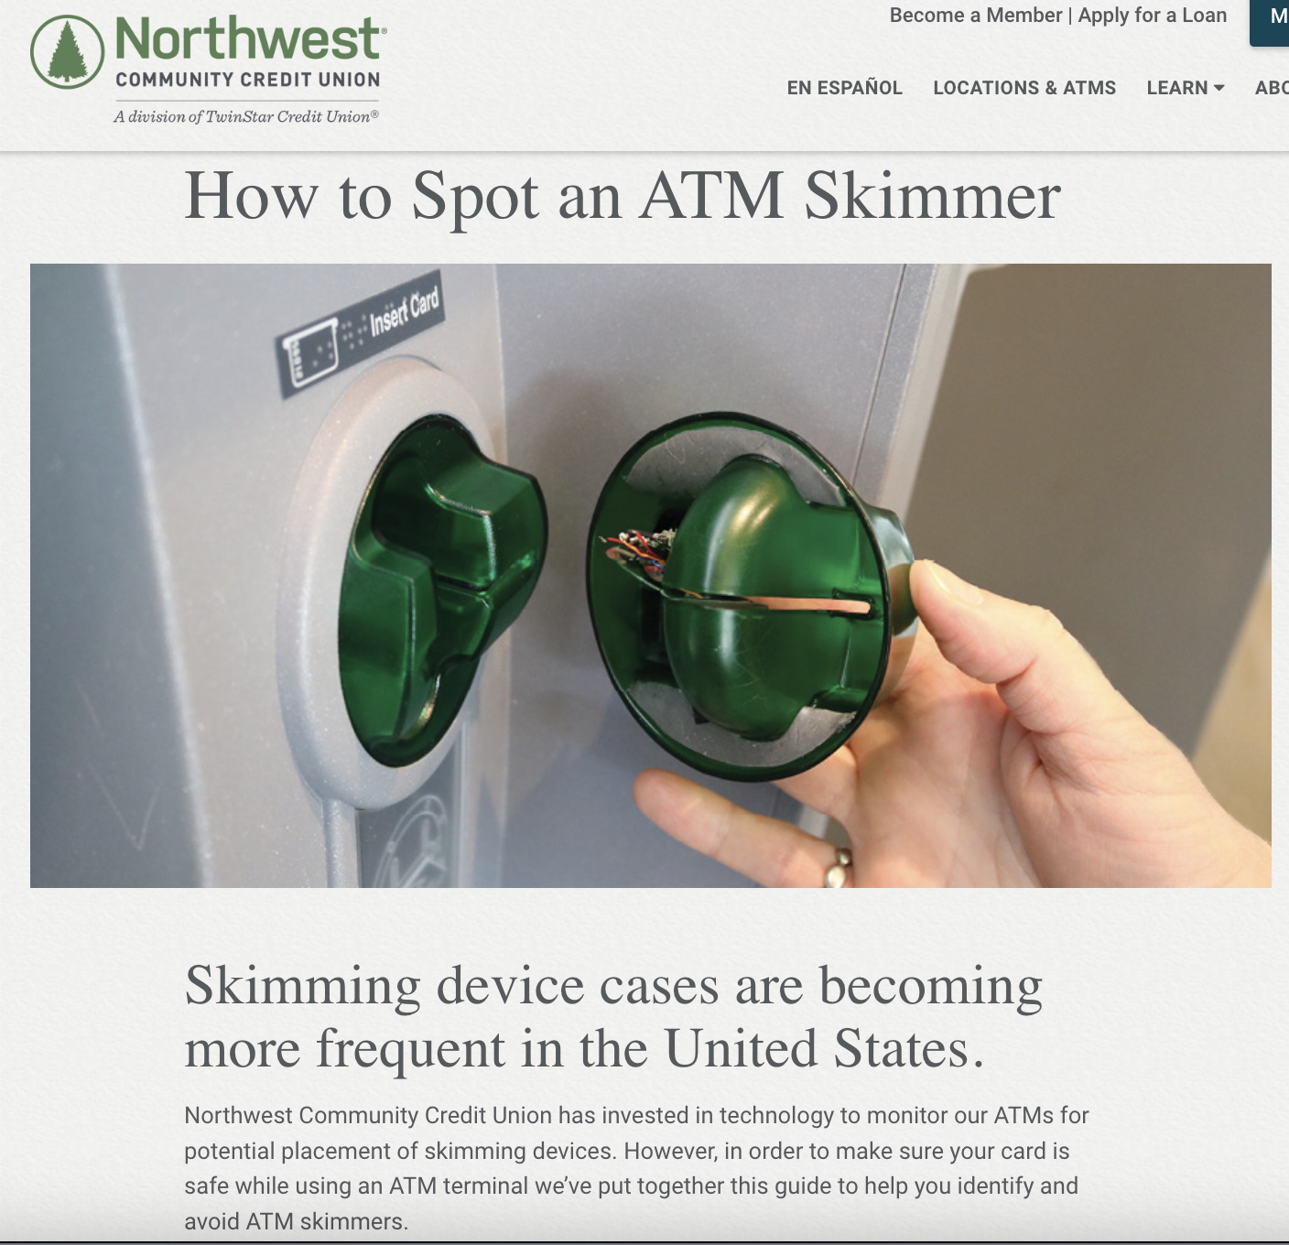
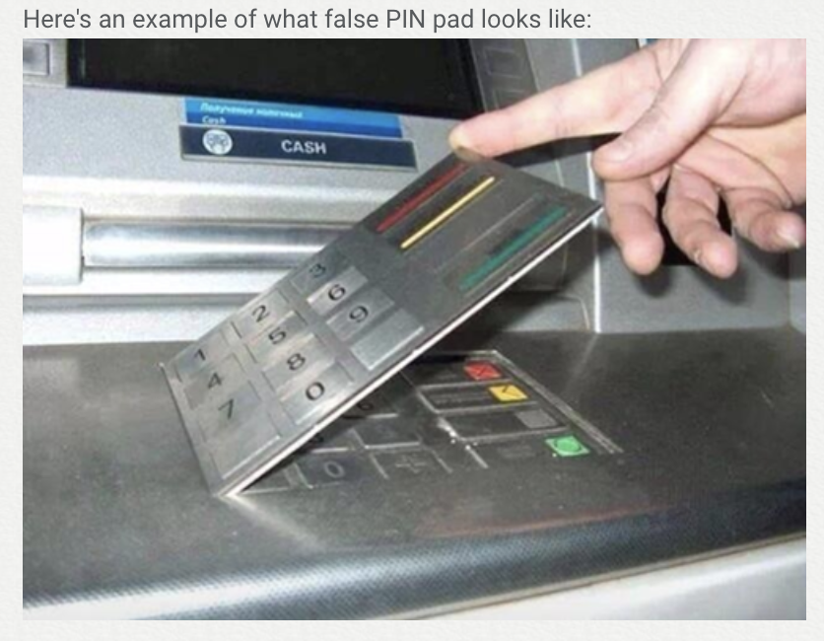
Source: https://www.nwcu.com/learn/how-spot-atm-skimmer

Slide 4
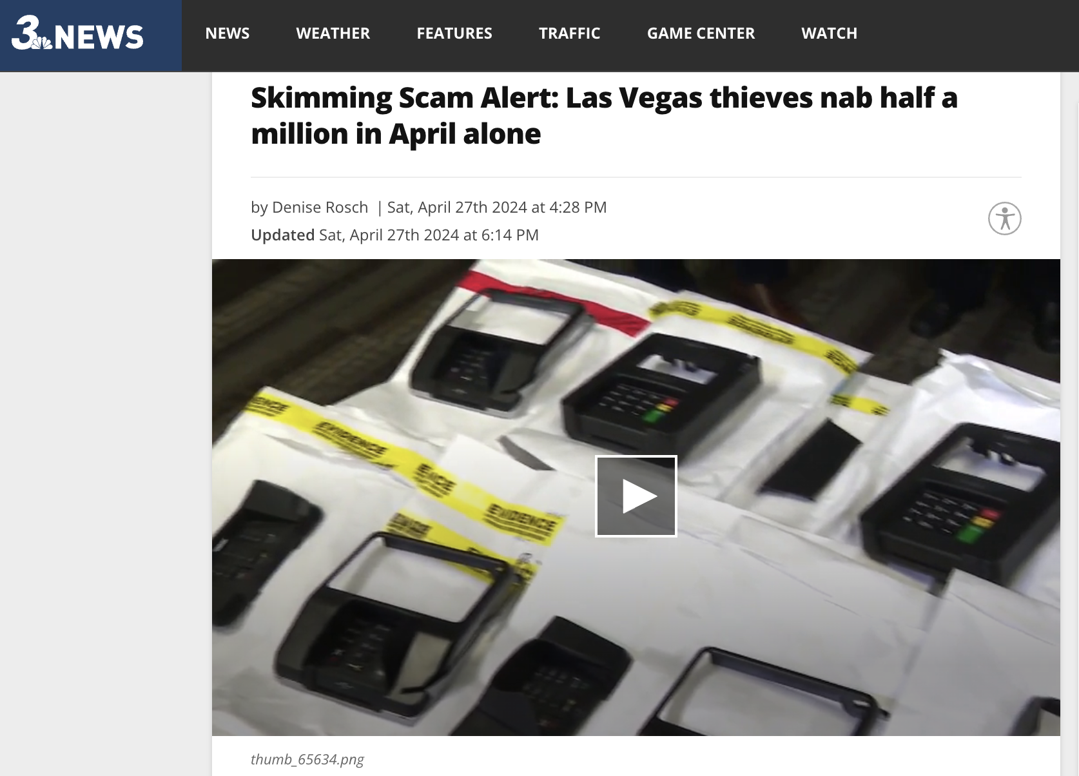
Source: https://news3lv.com/news/local/skimming-scam-alert-las-vegas-thieves-nab-half-a-million-in-april-alone

Slide 5

Persona
Sarah relies on ATMs for quick cash access but expects a secure and efficient experience. With the rise of ATM-related scams, she worries that using an ATM might expose her card details or PIN. She feels particularly unsafe when using ATMs in isolated locations, where the risk of skimming might be higher.
How can we utilize facial recognition technology to provide additional security for bank customers?

Slide 6
Problem Statement
Existing security measures might not be sufficient to identify and prevent fraudulent withdrawal. Therefore, we need a system that leverages existing ATM infrastructure to introduce an additional layer of security.
How can we utilize profiling using computer vision to provide additional security for bank customers?

Slide 7
How does it work?
Analyze video footage captured by ATM cameras
1
Detect the age, gender, and race of the ATM user
2
Compare with the cardholder’s profile
3
Identify discrepancies that might be suspicious
4
Trigger real-time alerts to the cardholder or bank
5
Notes:
Current situation vs my proposed idea

Slide 8
Machine learning models
Face Detection model
Gender classification model
Race classification model
Age classification model
8
Notes:
classification

Slide 9
Data collection and pre-processing

Slide 10
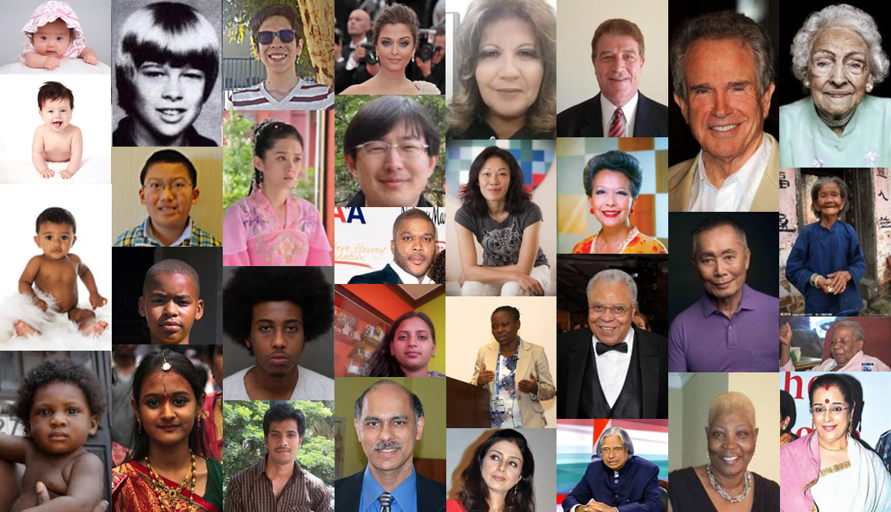
Dataset used
UTKFace
The raw data utilized for this project is the UTKFace dataset.
It is a large-scale face dataset encompassing a wide age range, from 0 to 116 years old.
The dataset comprises over 23,000 face images annotated with
Gender
Race
Age

Slide 11
Augmentation on training datasets
Augmentation types | Value | Description
Width shift | 20% | Randomly shifts the image horizontally along the width by up to 20% of the total width, enhancing model robustness to object position variations.
Height shift | 20% | Randomly shifts the image vertically along the height by up to 20% of the total height, similar to the width shift but in the vertical direction.
Shear | 20% | Applies a shear transformation, slanting the image along one axis, helping simulate perspective changes.
Zoom | 20% | Randomly zooms the image in or out by up to 20%, making the model more resilient to changes in the object's apparent size.
Horizontal flip | NA | Randomly flips the image horizontally (like looking in a mirror), helping prevent the model from developing biases based on left/right orientation.

Slide 12





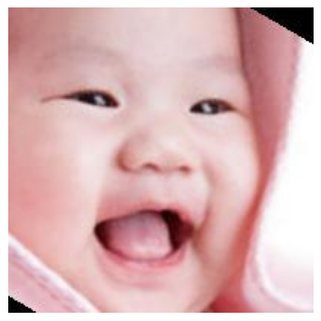
Augmentation on training datasets
Original
Width shift
Horizontal flip
Height shift
Zoom
Shear

Slide 13
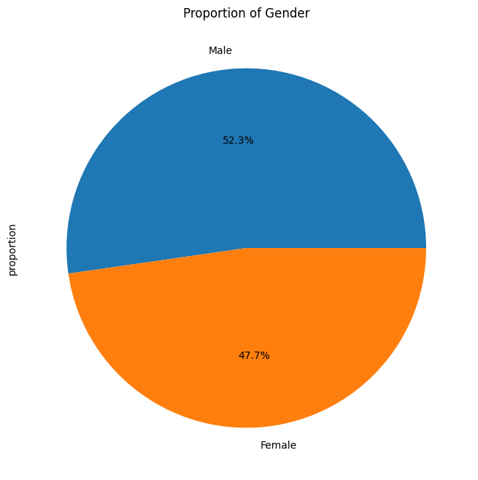
Gender
The proportion of Male and female is balanced

Slide 14
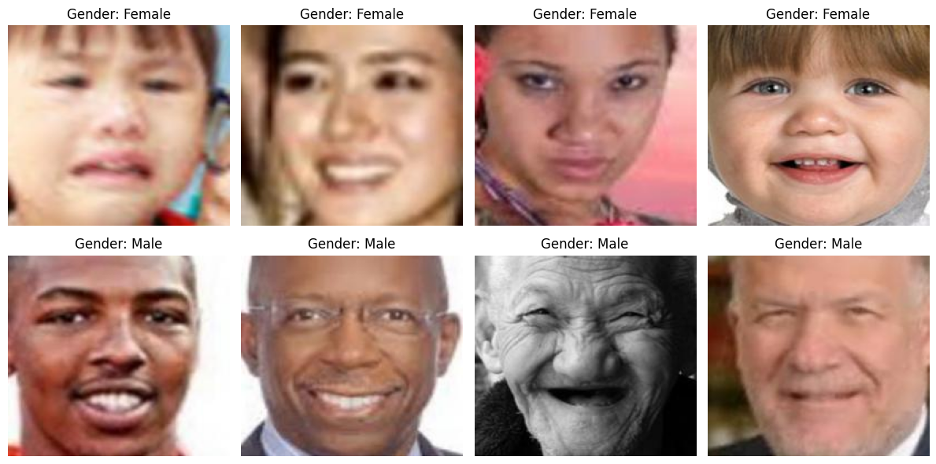
Gender
Some examples of Male and Female datasets:

Slide 15
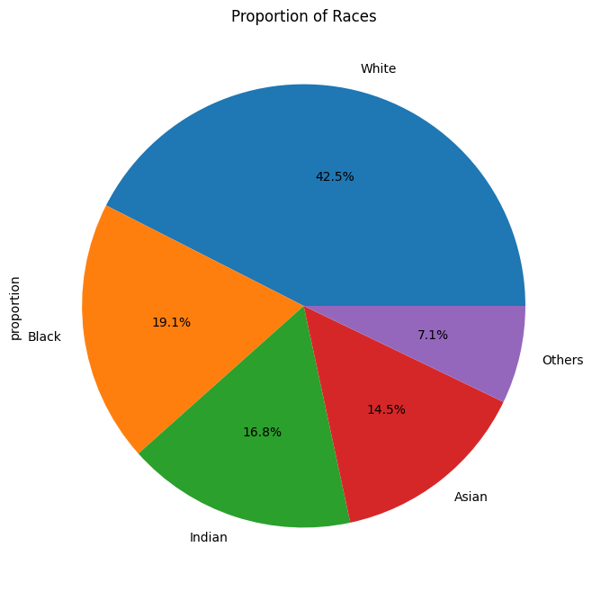
Race
White has the highest proportion in the dataset, followed by Black, Indian, Asian and Others.

Slide 16
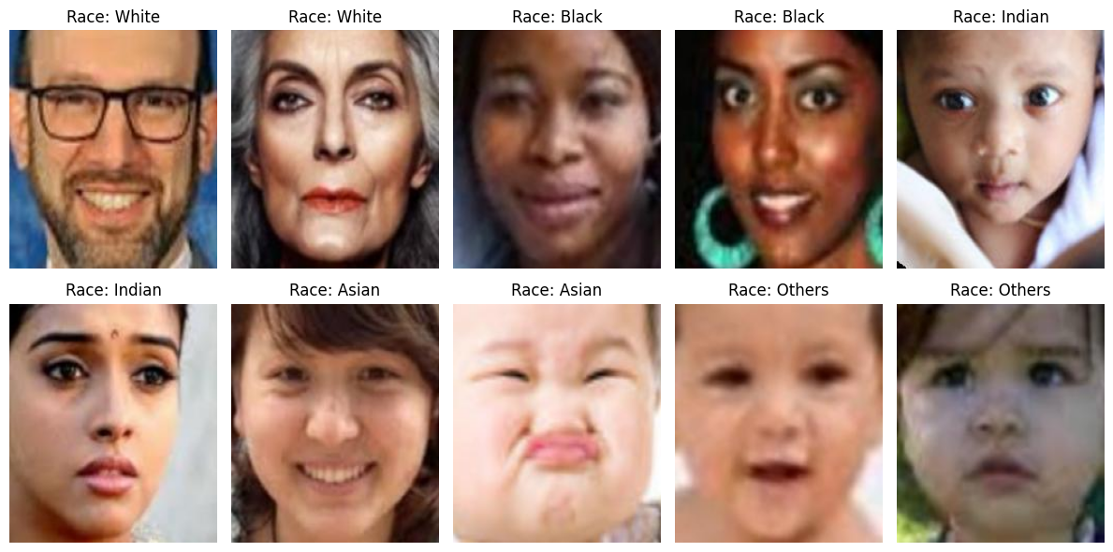
Race
Some examples of racial datasets:

Slide 17
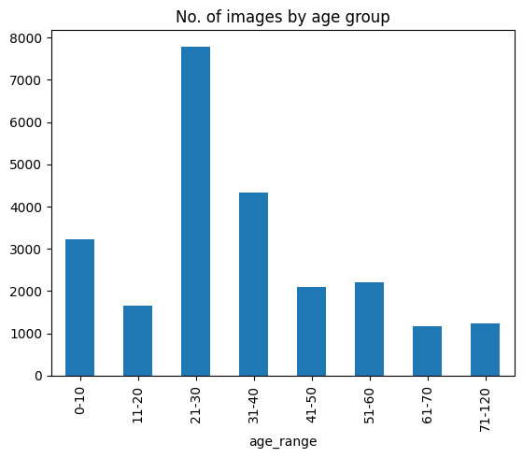
Age
Age group ‘21-30’ has the highest proportion

Slide 18
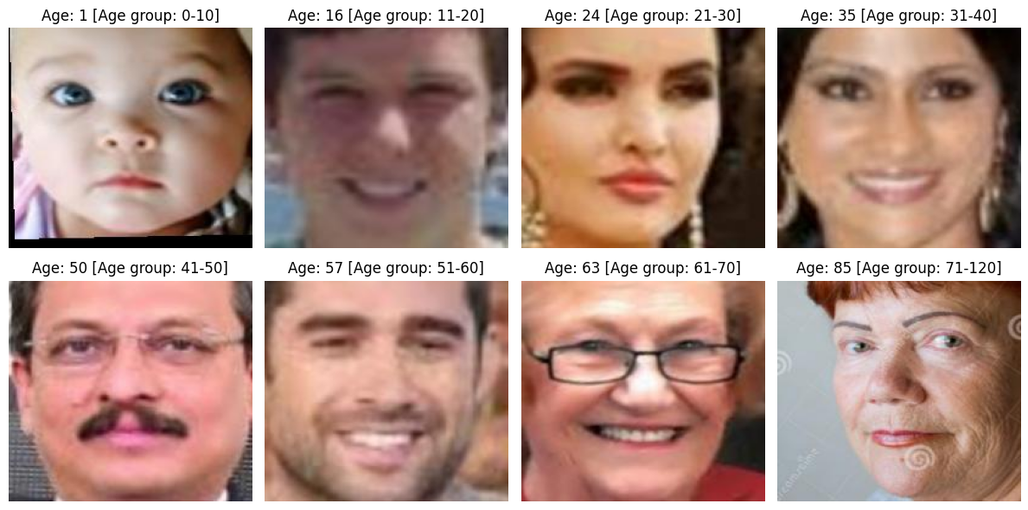
Age
Some examples of age datasets:

Slide 19
Modelling

Slide 20
Modelling process
Gender/Race/Age
The best base model
CNN (Convolutional Neural Network)
Output
Hyperparameter tuning
Base models
VGGFace
(Pre-trained)
ResNet
(Pre-trained)
20

Slide 21
Machine learning models
Face Detection model
Gender classification model
Race classification model
Age classification model
21
Notes:
classification

Slide 22
Machine learning models
Face Detection model
Gender classification model
Race classification model
Age classification model
22
Notes:
classification

Slide 23

Gender Classification model

Slide 24
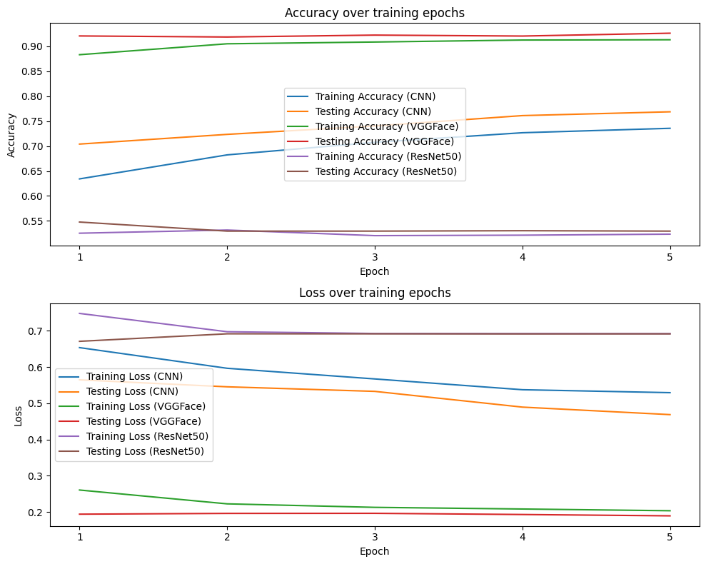
Base models

Slide 25
Base models
VGGFace is the best!

Slide 26
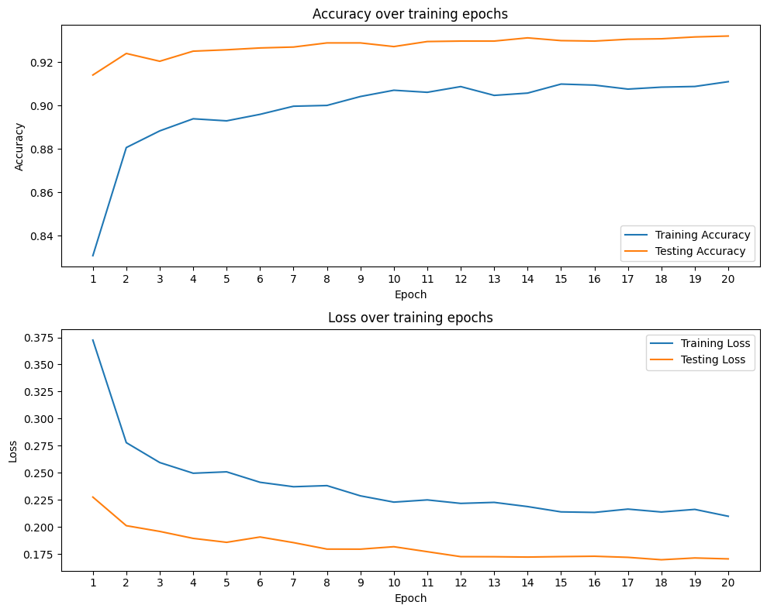
VGGFace after tuning
Both accuracy and loss improved!

Slide 27
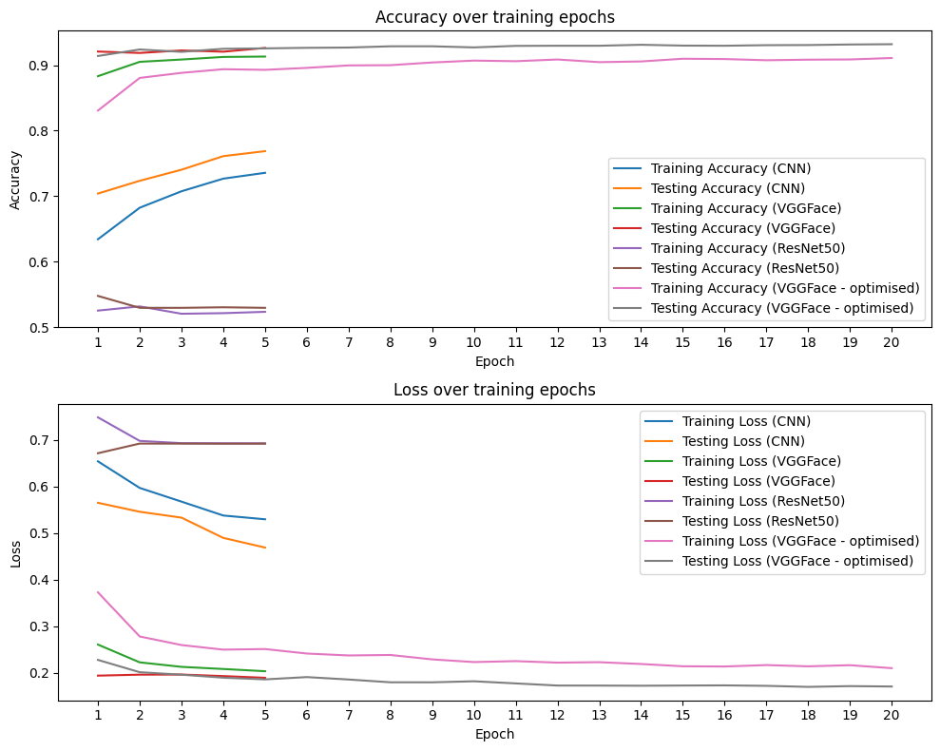
Model evaluation
Both accuracy and loss improved
Increased training epochs to 20 from 5
Early stopping kicked in at 19th epoch

Slide 28
Other metrics – weighted average
Accuracy
0.93
Precision
0.93
Recall
0.93
F1 score
0.93

Slide 29
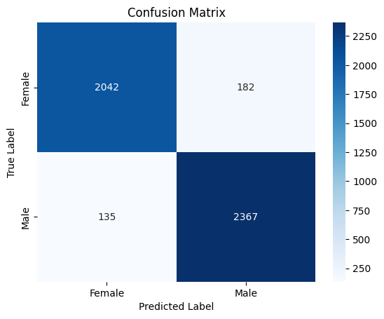
Confusion Matrix

Slide 30
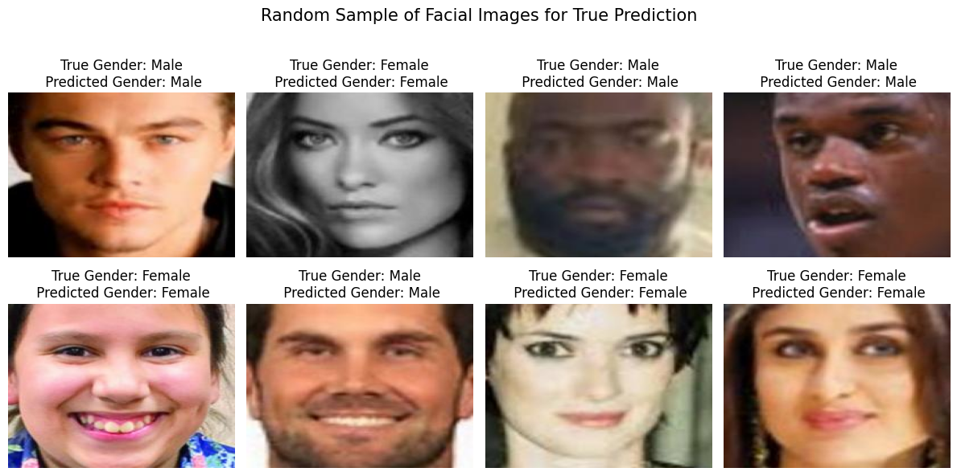
Samples of True Prediction

Slide 31
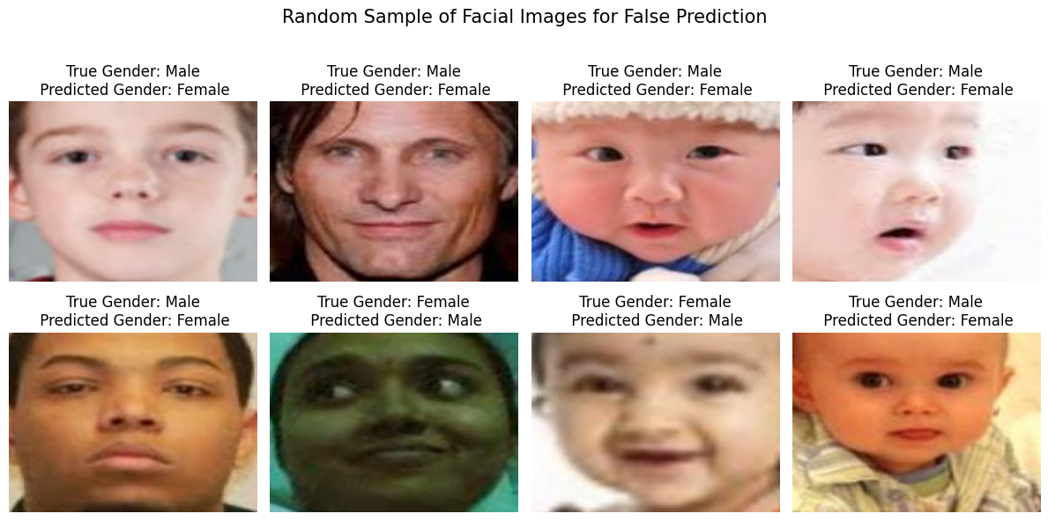
Samples of False Prediction

Slide 32
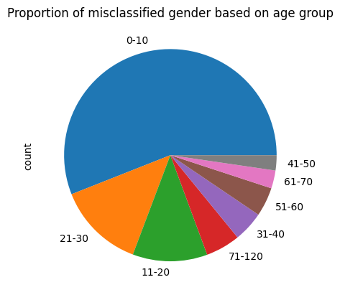
Proportion of misclassified gender based on age group

Slide 33
Machine learning models
Face Detection model
Gender classification model
Race classification model
Age classification model
33
Notes:
classification

Slide 34
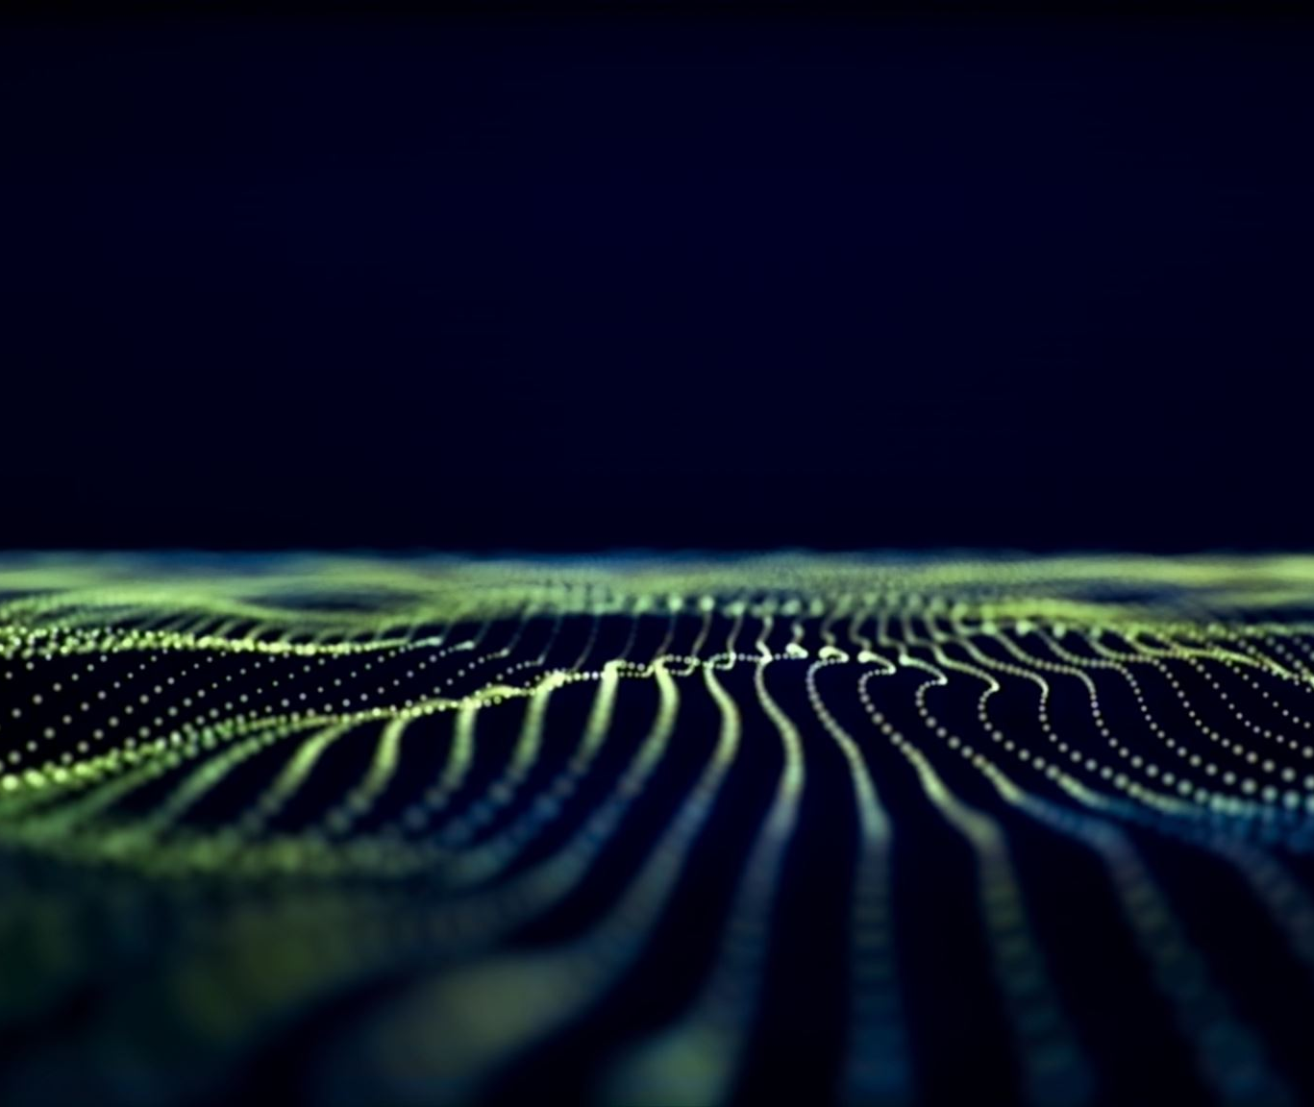
Race Classificationmodel

Slide 35
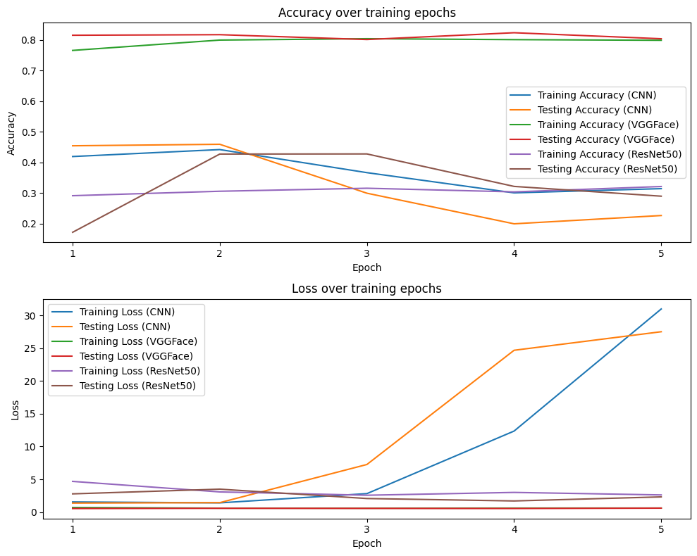
Base models

Slide 36
Base models
Again, VGGFace is the best!

Slide 37
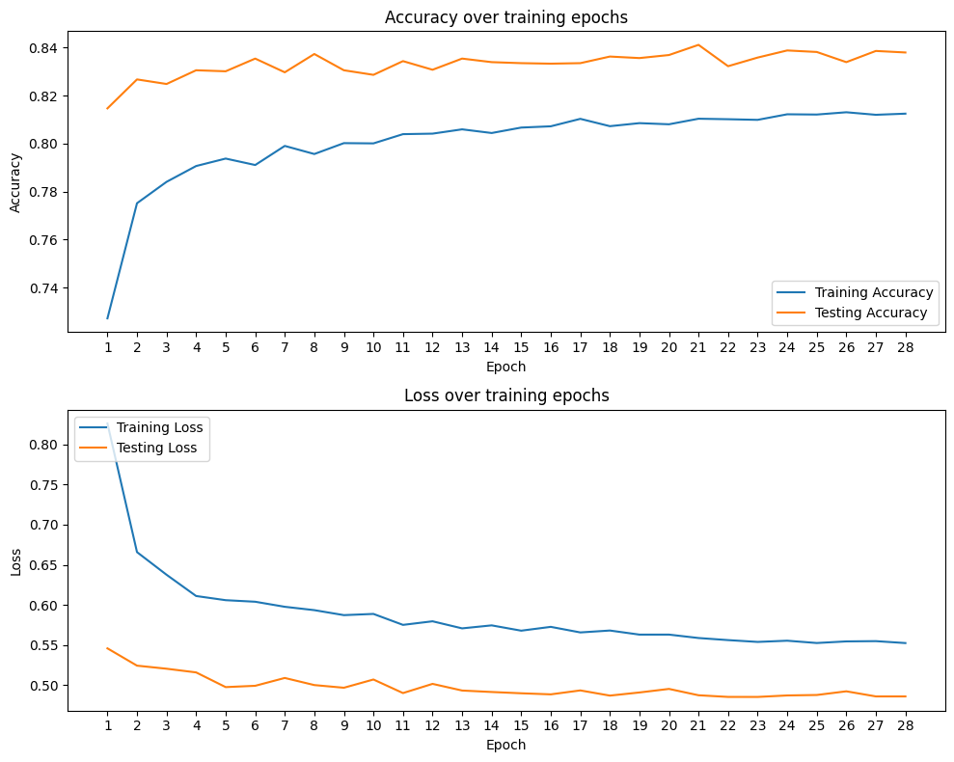
VGGFace after tuning
Both accuracy and loss improved!

Slide 38
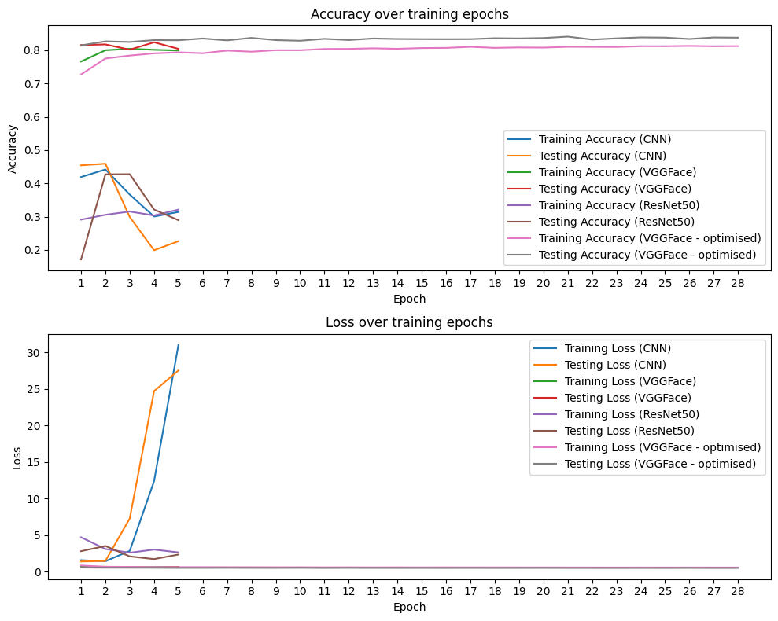
Model evaluation
Both accuracy and loss improved
Increased training epochs to 30 from 5
Early stopping kicked in at 28th epoch

Slide 39
Other metrics – weighted average
Accuracy
0.84
Precision
0.83
Recall
0.84
F1 score
0.83

Slide 40
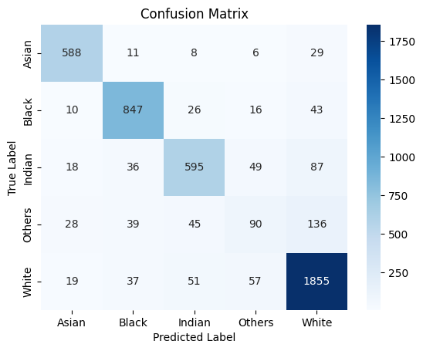
Confusion Matrix

Slide 41
Confusion Matrix
TP

Slide 42
Confusion Matrix
TP
FN

Slide 43
Confusion Matrix
TP
FN
FP

Slide 44
Confusion Matrix
TP
FN
FP
TN

Slide 45
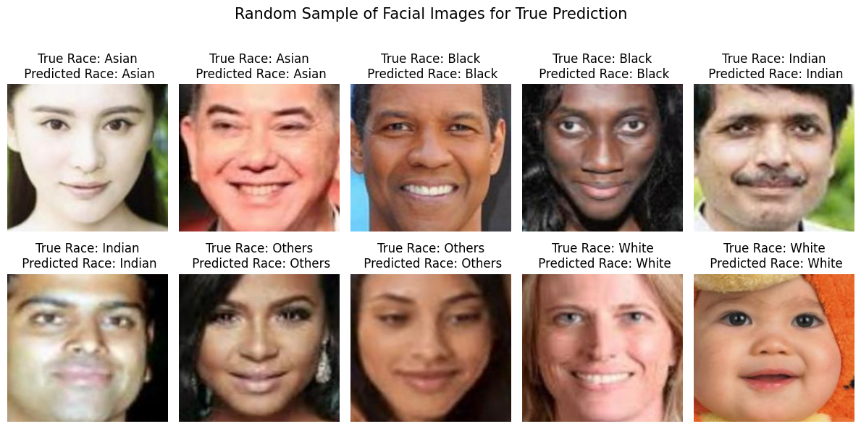
Samples of True Prediction

Slide 46
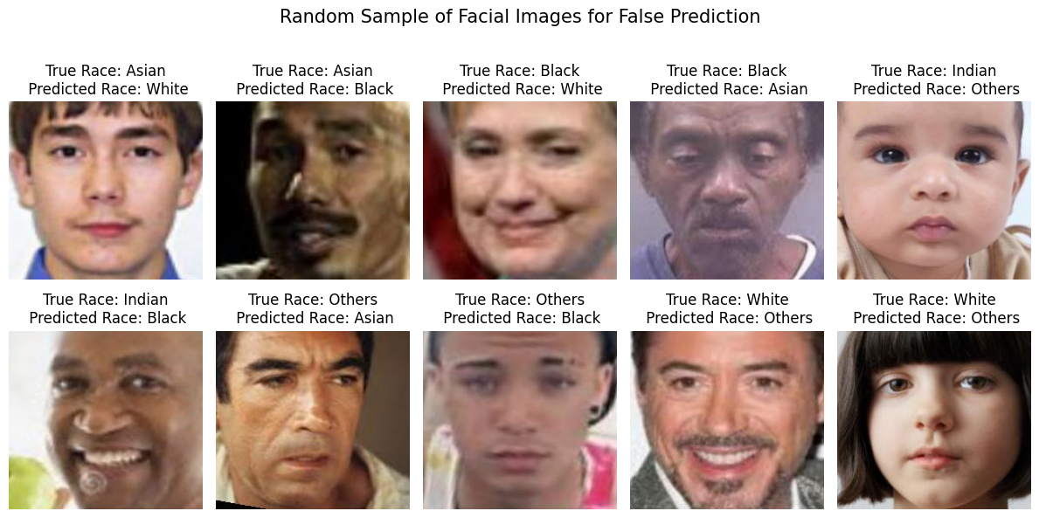
Samples of False Prediction

Slide 47
Machine learning models
Face Detection model
Gender classification model
Race classification model
Age classification model
47
Notes:
classification

Slide 48
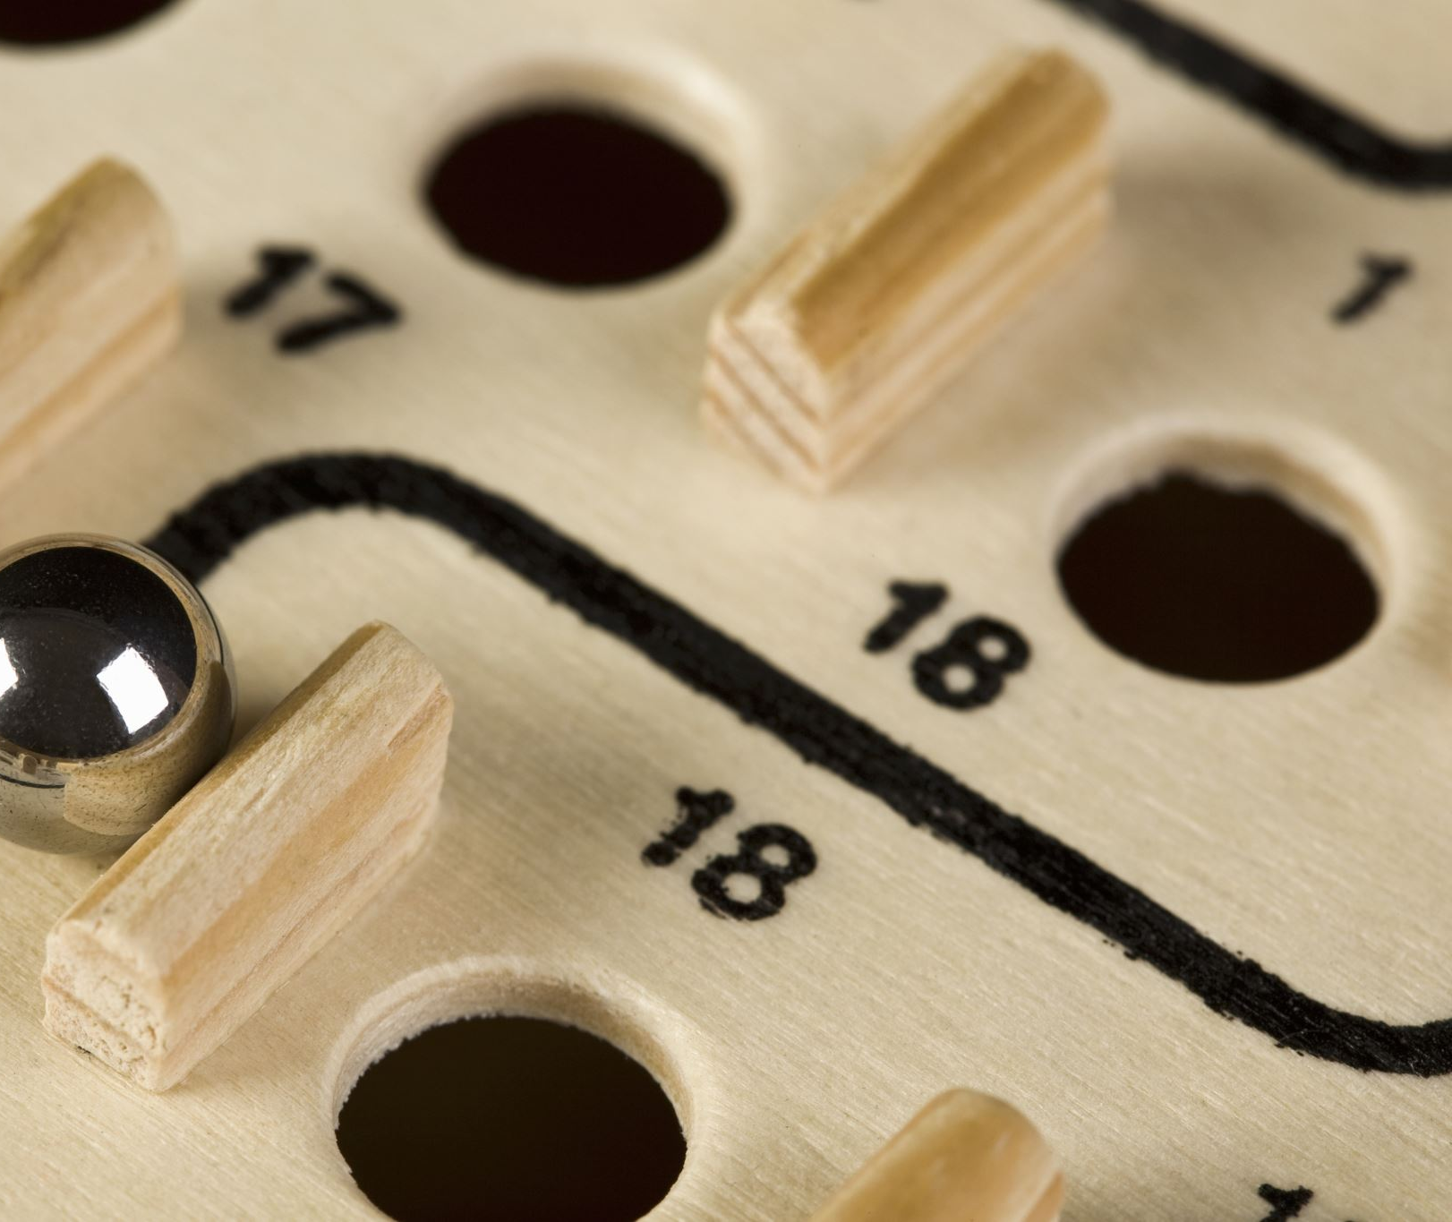
Age Classification model

Slide 49
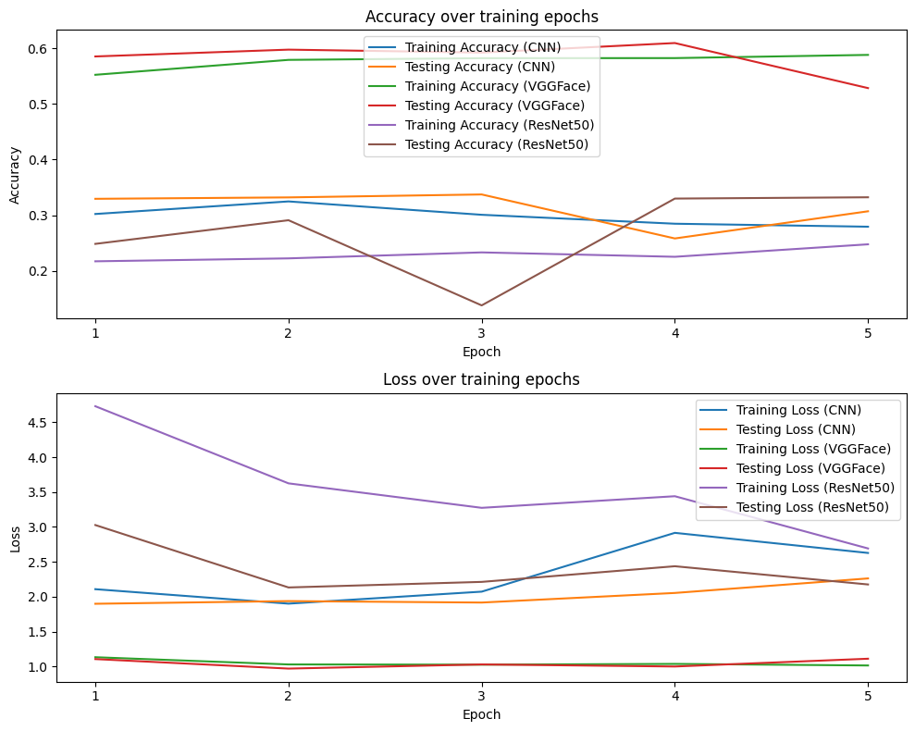
Base models

Slide 50
Base models
Again, VGGFace is the best!

Slide 51
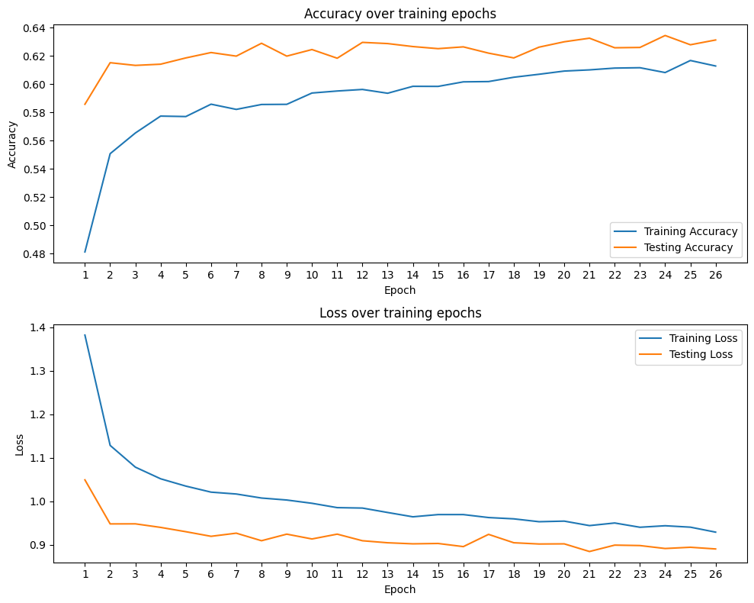
VGGFace after tuning
Both accuracy and loss improved!

Slide 52
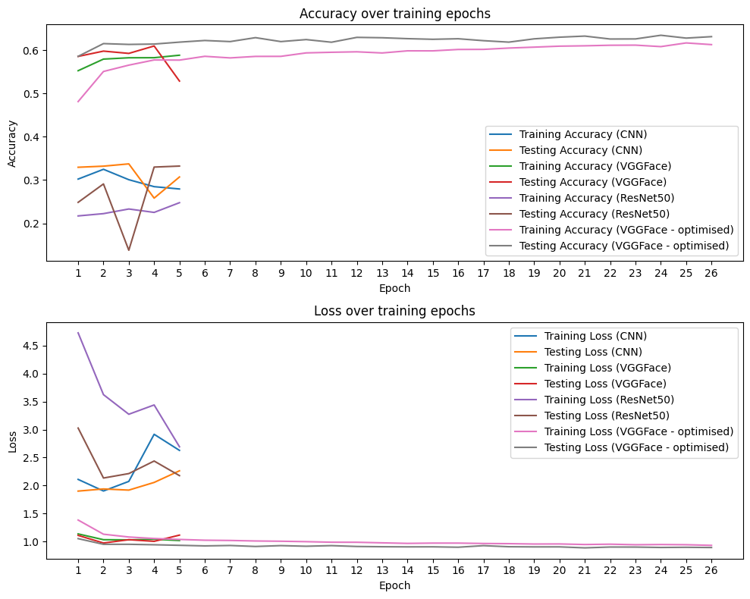
Model evaluation
Both accuracy and loss improved
Increased training epochs to 30 from 5
Early stopping kicked in at 26th epoch

Slide 53
Other metrics – weighted average
Accuracy
0.63
Precision
0.63
Recall
0.63
F1 score
0.62

Slide 54
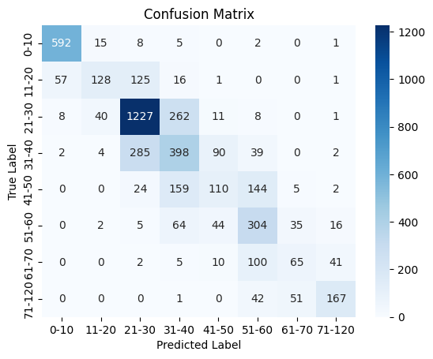
Confusion Matrix

Slide 55
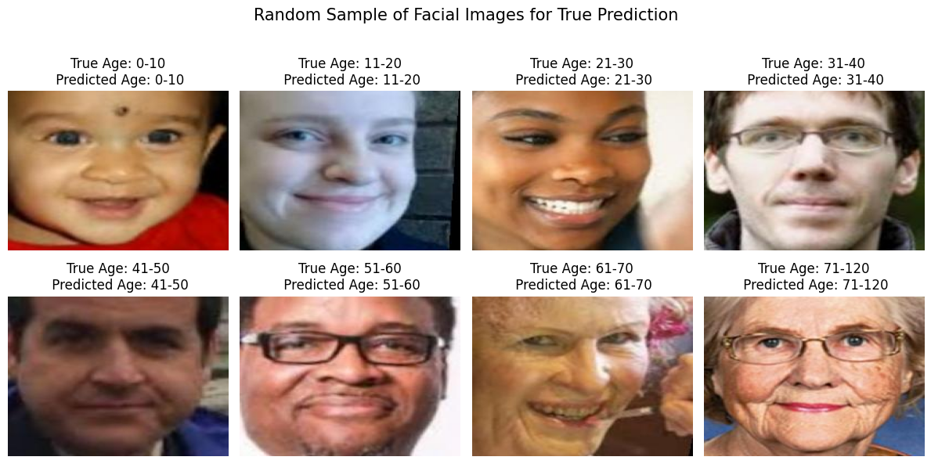
Samples of True Prediction

Slide 56
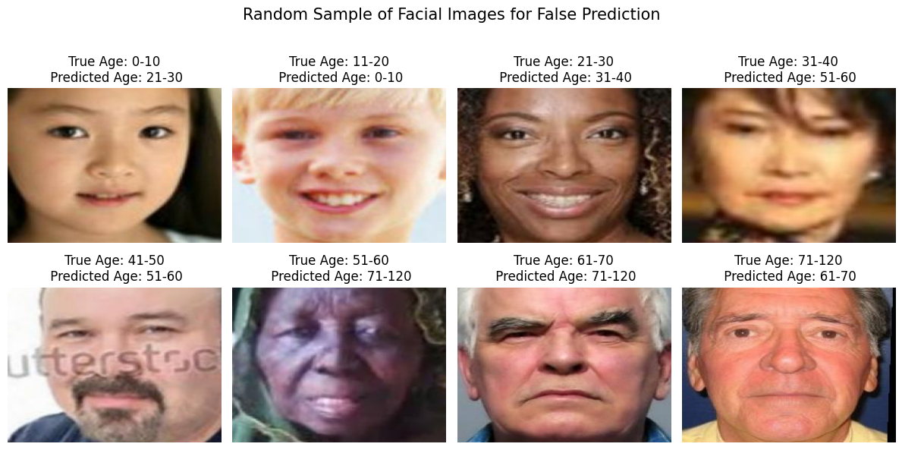
Samples of False Prediction

Slide 57
Machine learning models
Face Detection model
Gender classification model
Race classification model
Age classification model
57
Notes:
classification

Slide 58
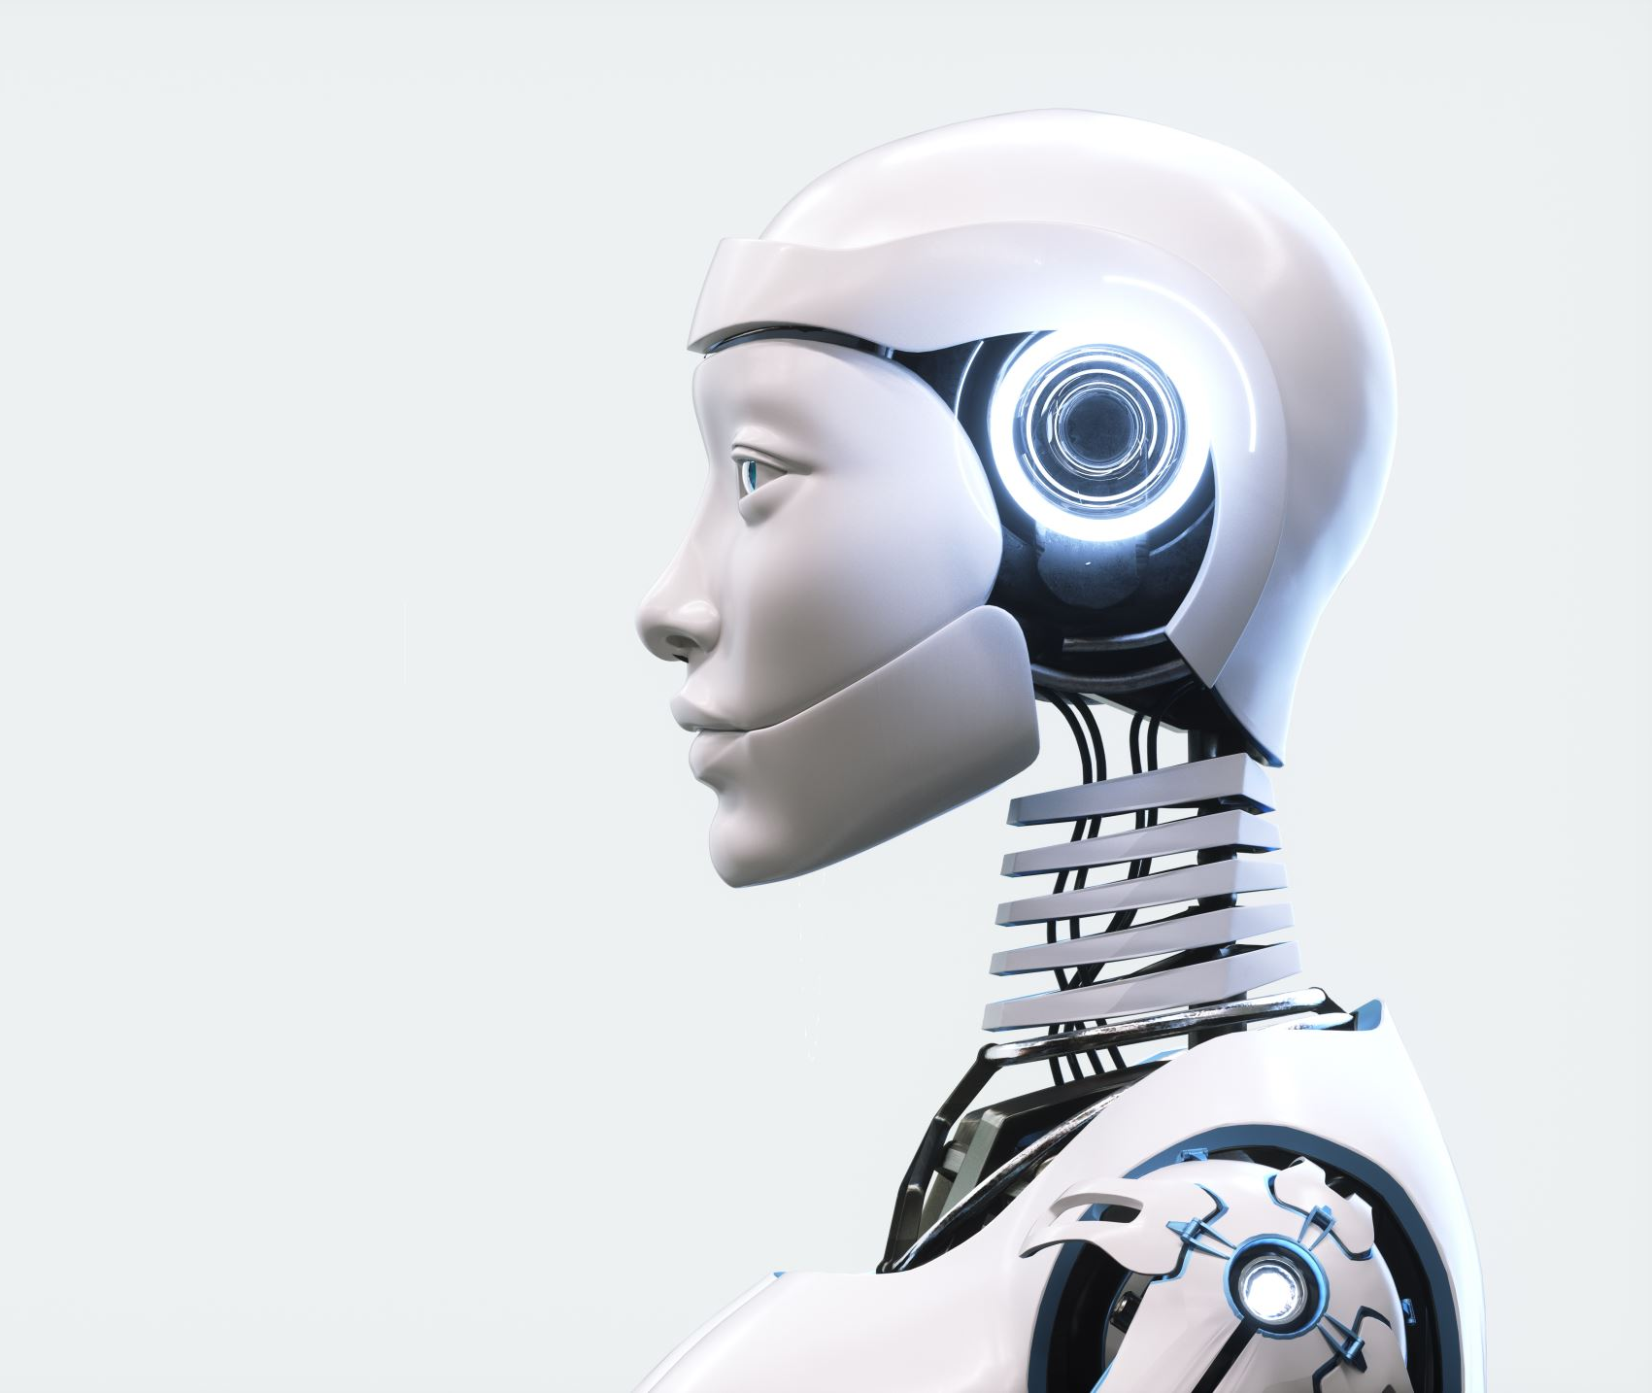
Face Detection Model

Slide 59
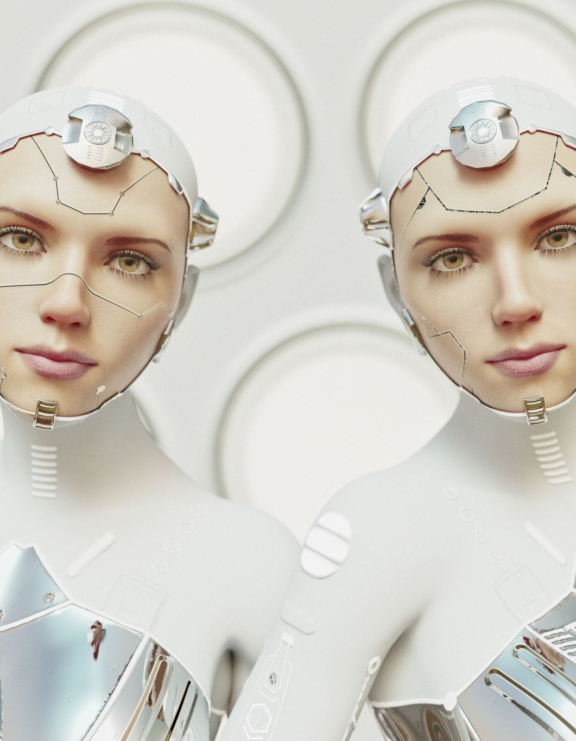
Face Detection model
MTCNN is a powerful tool for finding faces in images and videos. It's accurate, fast, and works well even in challenging conditions. This makes it a popular choice for tasks like facial recognition, image annotation, and emotion detection in videos.

Slide 60


Face Detection model
Faces
Gender
Age
Face Detection
Predictive model
Output
Race
Images or videos with labelled faces
Image or video

Slide 61
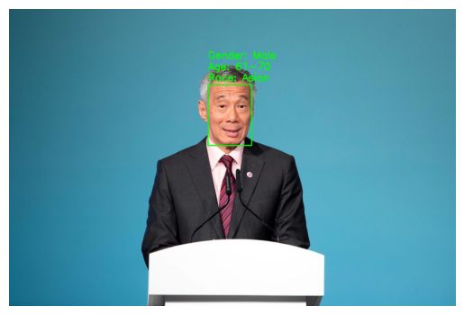
Face Detection on a single-face image

Slide 62
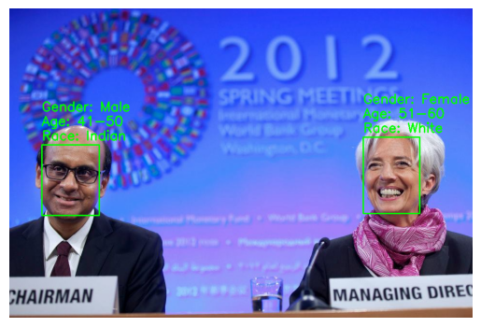
Face Detection on a multiple-faces image

Slide 63
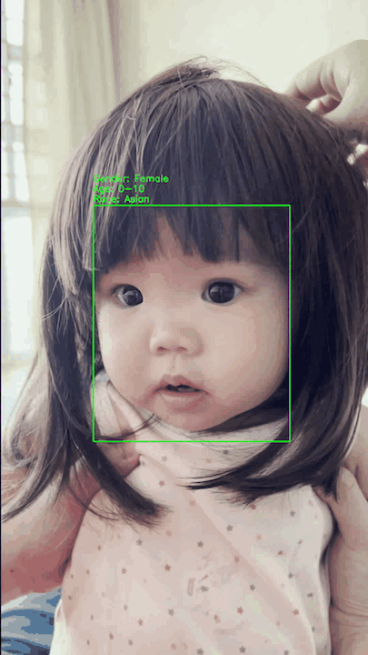
Face Detection on a single-face video

Slide 64
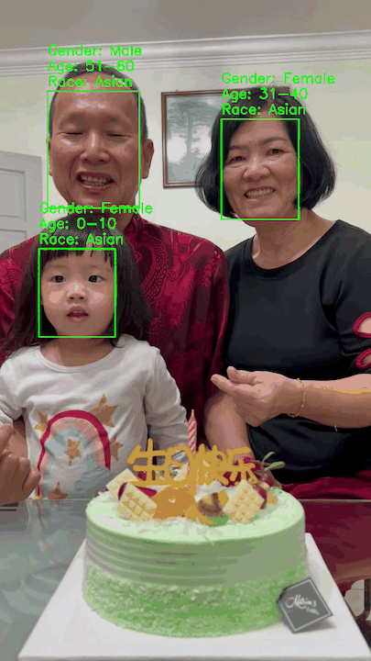
Face Detection on a multiple-faces video

Slide 65

Demo – Face detection on ATM customers

Slide 66
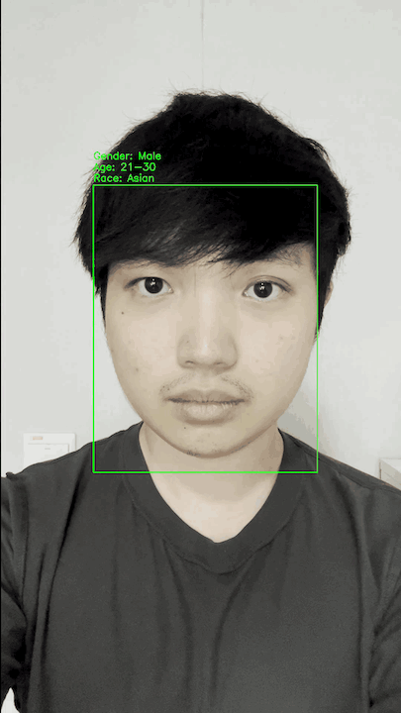
Video 1

Slide 67
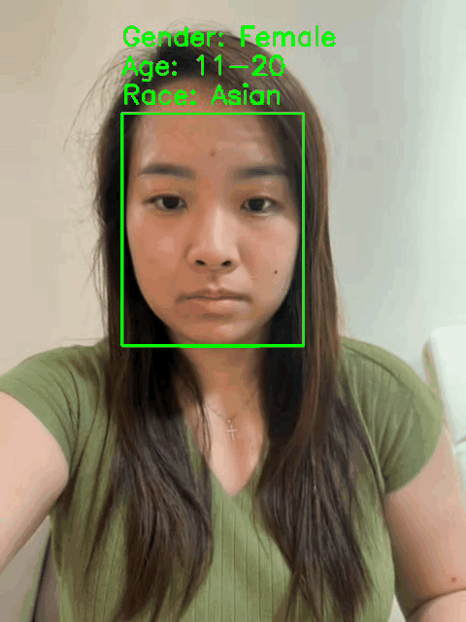
Video 2

Slide 68
Machine learning models
Face Detection model
Gender classification model
Race classification model
Age classification model
68
Notes:
classification

Slide 69
Limitation of the models
Age model
The model has limited accuracy (0.6) when trying to determine age from facial features.
This is because judging age from appearance alone is difficult and subjective, as people can look much younger or older than their actual age.
Gender and Race model
Despite good performance in gender and race prediction, the model might be inaccurate due to limitations of facial features.
Just like age, appearance can vary significantly from a person's actual gender and race.
Face Detection model
The model cannot detect faces with face masks on.

Slide 70


What’s next?
Appearance age
Due to the difference between appearance and actual demographics, banks might need to store additional data about a customer's perceived appearance.
In cases like a 30-year-old customer consistently appearing like a 20-year-old, the system should adapt to recognize their "appearance age".
This solves the problem of profiles mismatching a customer's visual presentation.
Banks may consider mandatory mask removal for cash withdrawals at ATMs.

Slide 71
Conclusion
The models effectively tackle the problem statement by enhancing ATM security.
The models improve ATM security by using face detection to flag suspicious withdrawals where the person doesn't match the cardholder. This builds customer trust in the bank's ATMs.
🥰🏦

Slide 72

Q&A

Slide 73

Thank you!

